Slide 1
Introduction to Databases CT042-3-1-IDB (version1)
Week 11: Extended Entity Relationship Model

Slide 2
Topic & Structure of The Lesson
Degrees of data abstraction
Entity Supertypes and Subtypes
Disjoint and Overlapping Constraints
Specialization and Generalization

Slide 3
Learning Outcomes
At the end of this topic, You should be able to
Describe 3 levels of data abstraction
Identify Entity Supertypes and Subtypes
Understand disjoint and overlapping Constraints

Slide 4
Key Terms You Must Be Able To Use
If you have mastered this topic, you should be able to use the following terms correctly in your assignments and exams:
External model
Conceptual model
Internal model
Entity supertype
Entity subtype

Slide 5
Data Models: A Summary
Each new data model capitalized on the shortcomings of previous models
Common characteristics:
Conceptual simplicity without compromising the semantic completeness of the database
Represent the real world as closely as possible
Representation of real-world transformations (behavior) must comply with consistency and integrity characteristics of any data model

Slide 6
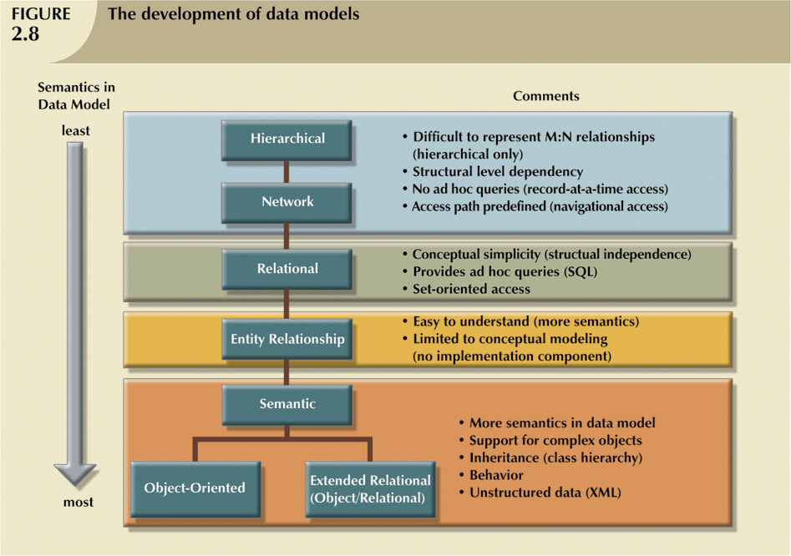
Data Models: A Summary (continued)

Slide 7
Degrees of Data Abstraction
Way of classifying data models
Many processes begin at high level of abstraction and proceed to an ever-increasing level of detail
Designing a usable database follows the same basic process

Slide 8
Degrees of Data Abstraction (continued)
American National Standards Institute (ANSI) Standards Planning and Requirements Committee (SPARC)
Defined a framework for data modeling based on degrees of data abstraction(1970s):
External
Conceptual
Internal

Slide 9
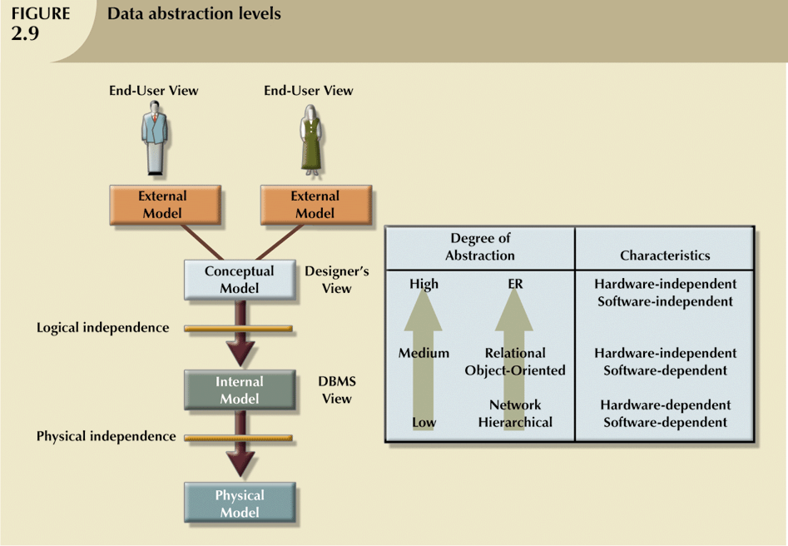
Degrees of Data Abstraction (continued)

Slide 10
The External Model
End users’ view of the data environment
Requires that the modeler subdivide set of requirements and constraints into functional modules that can be examined within the framework of their external models

Slide 11
The External Model (continued)
Advantages:
Easy to identify specific data required to support each business unit’s operations
Facilitates designer’s job by providing feedback about the model’s adequacy
Creation of external models helps to ensure security constraints in the database design
Simplifies application program development

Slide 12
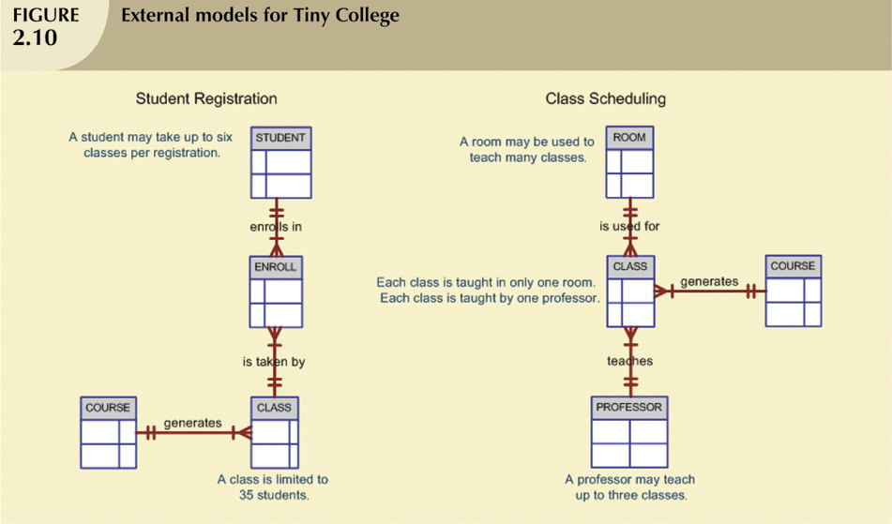
The External Model (continued)

Slide 13
The Conceptual Model
Represents global view of the entire database
Representation of data as viewed by the entire organization
Basis for identification and high-level description of main data objects, avoiding details
Most widely used conceptual model is the entity relationship (ER) model

Slide 14
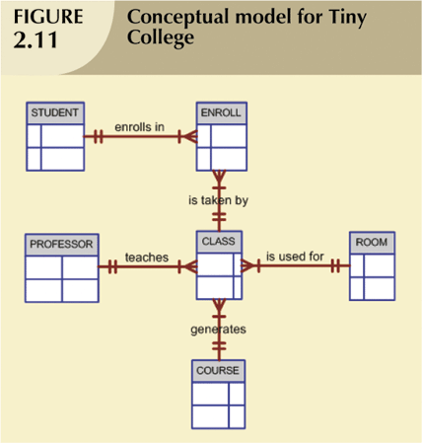
The Conceptual Model (continued)

Slide 15
The Conceptual Model (continued)
Provides a relatively easily understood macro level view of data environment
Independent of both software and hardware
Does not depend on the DBMS software used to implement the model
Does not depend on the hardware used in the implementation of the model
Changes in either hardware or DBMS software have no effect on the database design at the conceptual level

Slide 16
The Internal Model
Representation of the database as “seen” by the DBMS
Maps the conceptual model to the DBMS
Internal schema depicts a specific representation of an internal model

Slide 17
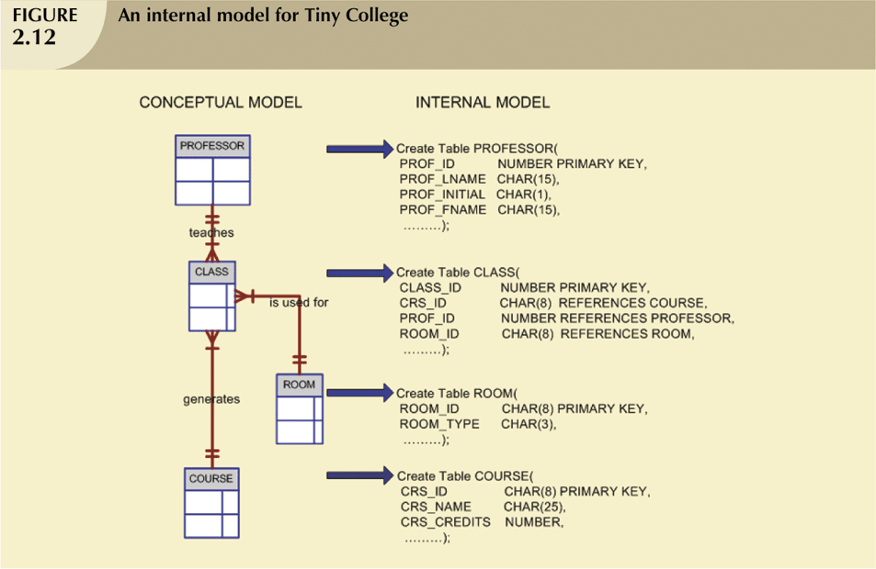
The Internal Model (continued)

Slide 18
The Physical Model
Operates at lowest level of abstraction, describing the way data are saved on storage media such as disks or tapes
Software and hardware dependent
Requires that database designers have a detailed knowledge of the hardware and software used to implement database design

Slide 19
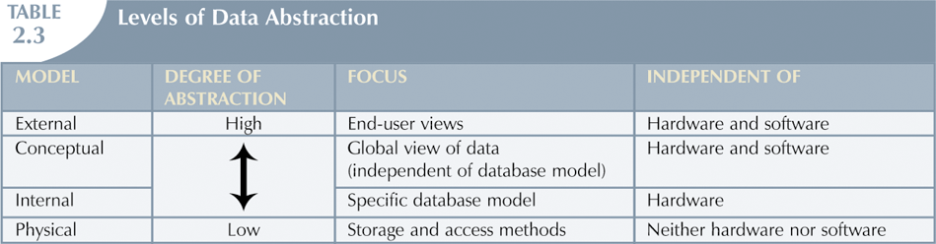
The Physical Model (continued)

Slide 20
In this chapter, you will learn:
About the extended entity relationship (EER) model’s main constructs
How entity clusters are used to represent multiple entities and relationships
The characteristics of good primary keys and how to select them
How to use flexible solutions for special data modeling cases
What issues to check for when developing data models based on EER diagrams

Slide 21
The Extended Entity Relationship Model
Result of adding more semantic constructs to original entity relationship (ER) model
Diagram using this model is called an EER diagram (EERD)

Slide 22
Entity Supertypes and Subtypes
Entity supertype
Generic entity type that is related to one or more entity subtypes
Contains common characteristics
Entity subtypes
Contains unique characteristics of each entity subtype

Slide 23
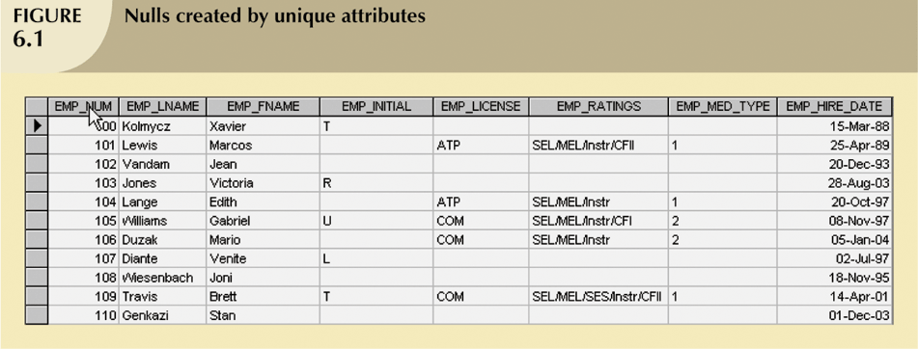
Entity Supertypes and Subtypes (continued)

Slide 24
Specialization Hierarchy
Depicts arrangement of higher-level entity supertypes (parent entities) and lower-level entity subtypes (child entities)
Relationships sometimes described in terms of “IS-A” relationships
Subtype can exist only within context of supertype and every subtype can have only one supertype to which it is directly related
Can have many levels of supertype/subtype relationships

Slide 25
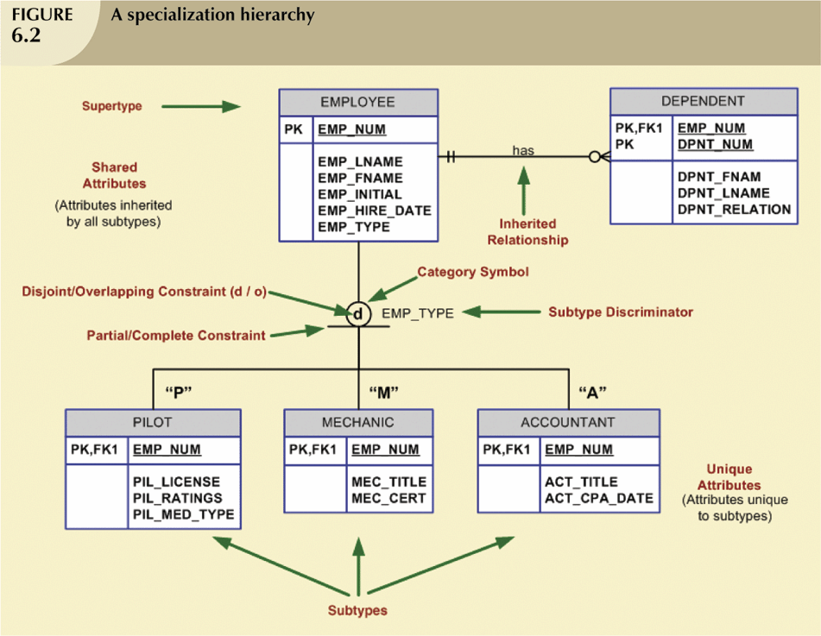
Specialization Hierarchy (continued)

Slide 26
Specialization Hierarchy (continued)
Support attribute inheritance
Define special supertype attribute known as subtype discriminator
Define disjoint/overlapping constraints and complete/partial constraints

Slide 27
Inheritance
Enables entity subtype to inherit attributes and relationships of supertype
All entity subtypes inherit their primary key attribute from their supertype
At implementation level, supertype and its subtype(s) depicted in specialization hierarchy maintain a 1:1 relationship

Slide 28
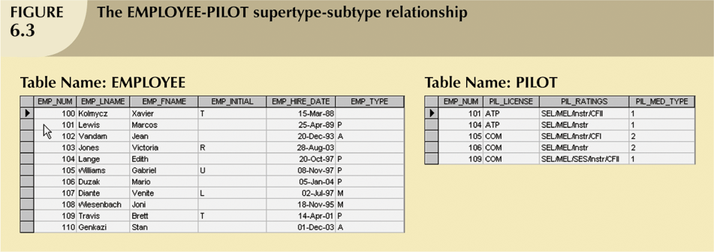
Inheritance (continued)

Slide 29
Subtype Discriminator
The attribute in supertype entity that determines to which entity subtype each supertype occurrence is related
The default comparison condition for subtype discriminator attribute is equality comparison

Slide 30
Disjoint and Overlapping Constraints
Disjoint subtypes
Also known as non-overlapping subtypes
Subtypes that contain unique subset of supertype entity set
Overlapping subtypes
Subtypes that contain nonunique subsets of supertype entity set

Slide 31
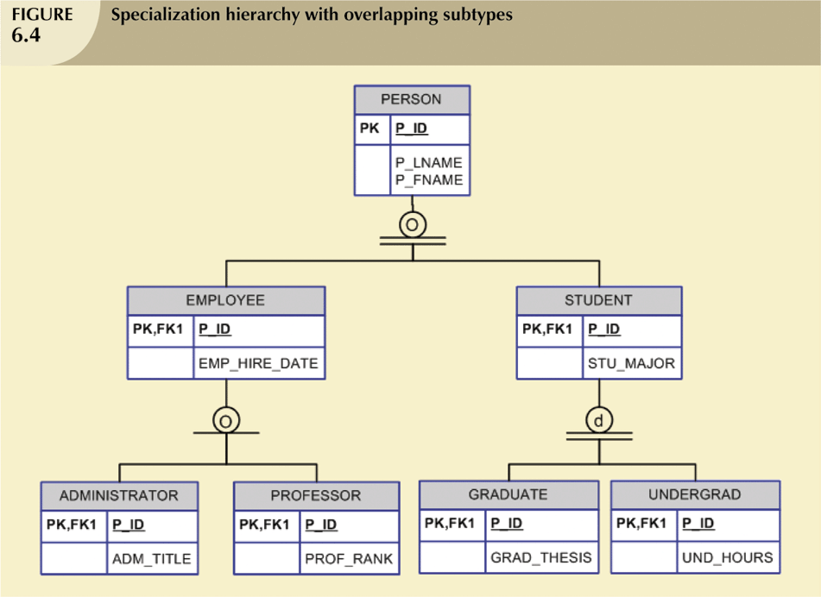
Disjoint and Overlapping Constraints (continued)

Slide 32
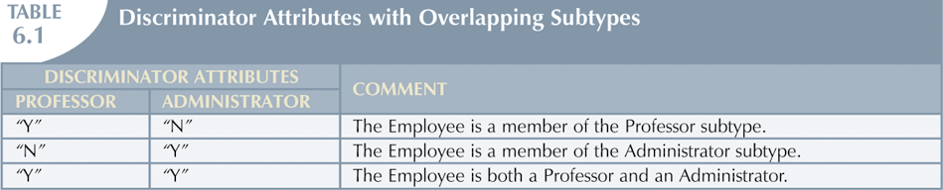
Disjoint and Overlapping Constraints (continued)

Slide 33
Completeness Constraint
Specifies whether each entity supertype occurrence must also be member of at least one subtype
Can be partial or total

Slide 34
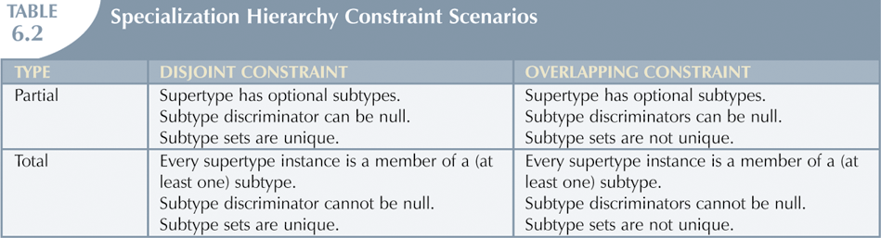
Completeness Constraint (continued)

Slide 35
Specialization and Generalization
Specialization
Top-down process of identifying lower-level, more specific entity subtypes from higher-level entity supertype
Based on grouping unique characteristics and relationships of the subtypes

Slide 36
Specialization and Generalization (continued)
Generalization
Bottom-up process of identifying higher-level, more generic entity supertype from lower-level entity subtypes
Based on grouping common characteristics and relationships of the subtypes

Slide 37
Quick Review Question
Describe the 3 levels of data abstraction.
Briefly explain what is entity supertype and subtype

Slide 38
Summary of Main Teaching Points
Extended entity relationship (EER) model adds semantics to ER model via entity supertypes, subtypes, and clusters
Specialization hierarchy depicts arrangement and relationships between entity supertypes and entity subtypes
Inheritance allows an entity subtype to inherit attributes and relationships of supertype

Slide 39
Question and Answer Session
Q & A

Slide 40
What we will cover next
Database Development Life Cycle

